Slide 1
EDUCATION SERIES #2
Business Case Scenario : From Prompt to Agent
Five layers — prompt, context, harness, loop, graph — taught through one
business story: Solstice Outfitters builds a support agent, week by week.
Ashley Castelino · 30-minute session

Slide 2
One build, five weeks, five layers
01
Prompt engineering
Instructions as an interface contract
02
Context engineering
The model only knows what you send
03
Harness engineering
The code you write around the model
04
Loop engineering
How a model becomes an agent
05
Graph engineering
Structuring many loops into a system
Building with LLMs
1

Slide 3
THE BUSINESS SCENARIO
Solstice Outfitters is drowning in support tickets
Outdoor-gear store, four-person support team, a queue that never empties.
80% of tickets are routine: order status, refunds, product questions.
Your brief: build an agent that resolves the routine ones — safely.
Solstice Outfitters is fictional; the constraints are typical of a small e-commerce team.
Building with LLMs
2

Slide 4
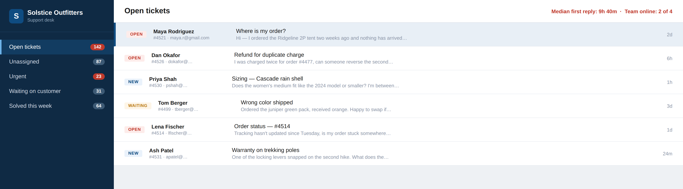
THE BUSINESS SCENARIO
Monday, 9 AM: the queue Maya's ticket is stuck in
Ticket #4521 — Maya's missing tent — is the one we'll follow for the rest of the talk.
UI mockup; company and data are fictional.
Building with LLMs
3

Slide 5
THE PLAN
The brief, translated from business asks into engineering
What the business needs | What that means technically
Answer “where is my order?” instantly | lookup_order tool calling the order API
Refunds follow policy; a human signs off on money | Policy in the prompt; approval guardrail in the harness
Replies match our published help docs | search_docs retrieval into the context window
We can see what the agent did, and why | Every turn of the loop logged and auditable
Each section ends in a live-code demo. Everything shown is provider-agnostic.
Building with LLMs
4

Slide 6
01
Prompt engineering
Week 1: the agent needs a job description — role, policy, examples, output format. That is the prompt.
Building with LLMs
5

Slide 7
LAYER 1
Prompt engineering
Writing the model's instructions the way you'd write an interface contract: role, task, constraints, examples, and the exact output format you expect back.
WHY IT MATTERS
Highest leverage per unit of effort — no retraining, no new infrastructure, just better instructions. Version it like code.(Imagine you are teaching someone for the job)
Building with LLMs
6

Slide 8
IN PRACTICE
Same model, two prompts, very different tickets
Vague
Engineered
“You are a helpful support agent. Answer the customer.”
Role + policy: refunds within 30 days, ≤ $200.
Refund policy gets improvised.
Two worked example replies (few-shot).
Output format changes run to run.
Output schema: JSON with reply, action, confidence.
Treat the prompt as versioned code: reviewed, tested, diffed.
Building with LLMs
7

Slide 9
THE EXAMPLE, LAYER 1
The engineered prompt, in full
You are the support agent for Solstice Outfitters.
POLICY
- Refunds: within 30 days of delivery, max $200 — otherwise escalate.
- Never promise delivery dates; quote the carrier's estimate.
OUTPUT — respond with JSON only:
{ "reply": "<message to the customer>",
"action": "none | refund | escalate",
"confidence": 0.0 - 1.0 }
EXAMPLES: two ideal ticket -> reply pairs pasted here (few-shot).
Role, policy, schema, examples — the whole contract, versioned in git next to the code.
Building with LLMs
8

Slide 10
EVIDENCE
Asking the model to reason step-by-step tripled math accuracy
Same model, same questions — only the prompt changed.
Wei et al. 2022; Wang et al. 2022 — PaLM 540B on GSM8K math word problems.
Building with LLMs
9

Slide 11
TOOLBOX
Four techniques cover most of what prompt engineering does
Technique | What it does | In our support agent
Role + constraints | Pins tone and policy limits | Refund rules stated up front
Few-shot examples | Shows the target, not tells it | Two ideal replies embedded
Output schema | Makes responses parseable | JSON: reply, action, confidence
Chain-of-thought | Buys reasoning on hard cases | “Check policy before refunding”
Building with LLMs
10

Slide 12
</>
LIVE CODE · PROMPT ENGINEERING
Demo: the prompt against real tickets
We'll run the vague and the engineered prompt on the same three tickets and diff the JSON that comes back.
Switching to the editor — the deck picks back up when we're done.
Building with LLMs
11

Slide 13
02
Context engineering
Week 2: the agent invents order details. It doesn’t need discipline — it needs the right facts in the window.
Building with LLMs
12

Slide 14
THE MENTAL MODEL
Every API call starts from zero — context is all the model gets
No memory between calls: “conversation” is you resending the history.
The window is finite — long inputs crowd out instructions.
Quality drops before limits do: models lose the middle of long contexts.
“Lost in the middle”: Liu et al., 2023.
Building with LLMs
13

Slide 15
WHAT'S IN THE WINDOW
The harness assembles the context fresh on every call
System prompt
History
Retrieved data
Tool results
Role, policy, tool specs
Recent turns, summarized
Order record, 3 relevant docs
This turn's outputs
For ticket #4521 the agent sees the refund policy, three turns, and one order record — not the database.
Building with LLMs
14

Slide 16
CONTEXT ENGINEERING
Spend the window like a budget, not a dumping ground
Retrieve the three relevant docs; don't paste the manual.
Summarize or drop old turns — keep decisions, not chatter.
Put critical instructions first and last; the middle gets skimmed.
Building with LLMs
15

Slide 17
THE EXAMPLE, LAYER 2
What the window actually holds for ticket #4521
[system] Role, policy, tool specs ~600 tokens
[history] Turns 1-3, summarized to one line ~150
[retrieved] Order 4521 — shipped Aug 24, carrier: LOST ~120
[retrieved] Help docs, "Lost packages" (top match) ~200
[user] "It's been two weeks. Where is my order?" ~20
------------------------------------------------------------------
Total sent to the model ~1,090 tokens
Everything the model will ever know about this ticket — chosen, not dumped.
Token counts illustrative.
Building with LLMs
16

Slide 18
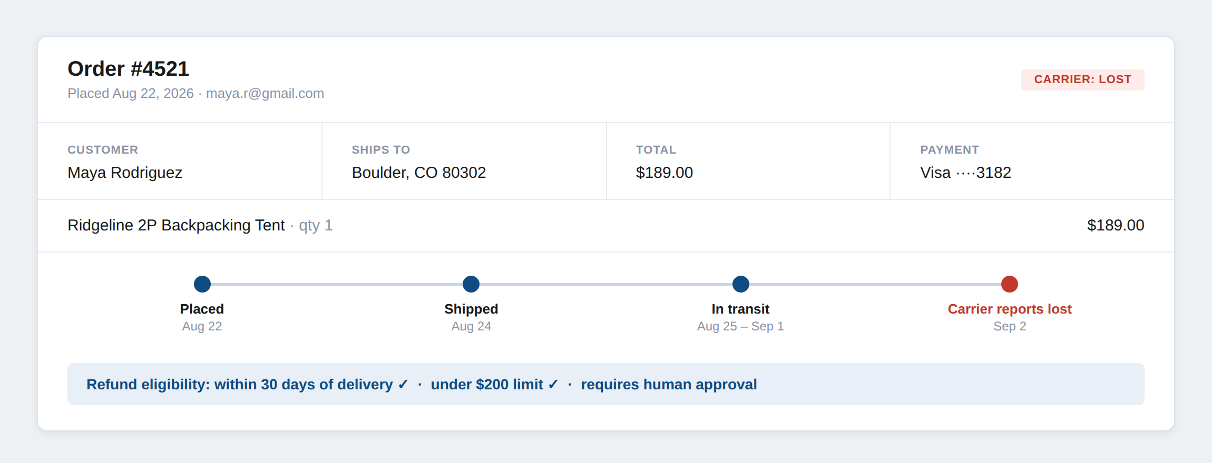
THE EXAMPLE, LAYER 2
“Retrieved data” is just this record, fetched at the right moment
The refund policy check is answerable only because this record is in the window.
UI mockup; data fictional.
Building with LLMs
17

Slide 19
</>
LIVE CODE · CONTEXT ENGINEERING
Demo: assembling the window
We'll build the context for ticket #4521 piece by piece and watch what retrieval adds — and what it costs.
Switching to the editor — the deck picks back up when we're done.
Building with LLMs
18

Slide 20
03
Harness engineering
Week 3: the prompt can’t call the order API. Time to write the code around the model.
Building with LLMs
19

Slide 21
LAYER 3
Harness
The application code wrapped around the model: it assembles context, exposes tools, parses and validates output, retries failures, and enforces guardrails.
WHY IT MATTERS
The model never runs a tool or touches your database — the harness does. Its permissions, not the model's intent, bound what can happen.
Building with LLMs
20

Slide 22
ANATOMY
One turn of the harness, end to end
Assemble
Call model
Validate
Execute
Prompt + context
The only LLM step
Parse JSON, check schema
Run tool, apply guardrails
Only the shaded step is the LLM. Everything else is deterministic code — testable, loggable, yours.
Building with LLMs
21

Slide 23
THE EXAMPLE, LAYER 3
The whole harness is one short function
def handle_turn(ticket):
ctx = assemble(SYSTEM_PROMPT, # layer 1: the prompt
summarize(ticket.history), # layer 2: context
retrieve(ticket))
out = call_model(ctx, tools=TOOLS) # the only LLM step
act = validate(out) # parse JSON, check schema
if act.tool == "refund_order":
require_human_approval(act) # guardrail
return execute(act) # run the tool
Layers 1 and 2 are just arguments here. The loop — next — is what calls this repeatedly.
Building with LLMs
22

Slide 24
</>
LIVE CODE · HARNESS ENGINEERING
Demo: handle_turn, end to end
One turn against a test ticket: assemble, call, validate — and what happens when the model returns bad JSON.
Switching to the editor — the deck picks back up when we're done.
Building with LLMs
23

Slide 25
04
Loop engineering
Week 4: one call handles one step, but ticket #4521 takes four. Wrap the harness in a loop.
Building with LLMs
24

Slide 26
LAYER 4
Agentic loop
Call the model → if it requests a tool, run it → append the result to context → call again. Repeat until the model answers instead of acting.
WHY IT MATTERS
The model decides what happens next at every step. That decision-making inside a loop is what “agent” actually means.
Building with LLMs
25

Slide 27
THE EXAMPLE, LAYER 4
The loop is ten lines wrapped around the harness
def run_agent(ticket, max_turns=8): # cap prevents runaways
history = []
for _ in range(max_turns):
act = handle_turn(ticket, history) # the harness, from layer 3
if act.tool is None: # model chose to reply
return act.reply # -> the exit condition
result = execute(act) # run the requested tool
history.append((act, result)) # context grows each turn
return escalate(ticket) # budget hit -> human
The model steers; the code decides how long it's allowed to drive.
Building with LLMs
26

Slide 28
TRACE
Ticket #4521 through the loop, turn by turn
1
User: “Ordered two weeks ago, nothing arrived.” Model calls lookup_order(4521).
2
Harness runs it — shipped 12 days ago, carrier reports lost — and appends the result.
3
Model reads it, calls refund_order(4521). Guardrail: pause for human approval.
4
Approved → harness refunds. Model writes the apology; no tool call → loop exits.
Four model calls, two tools, one resolved ticket.
Building with LLMs
27

Slide 29
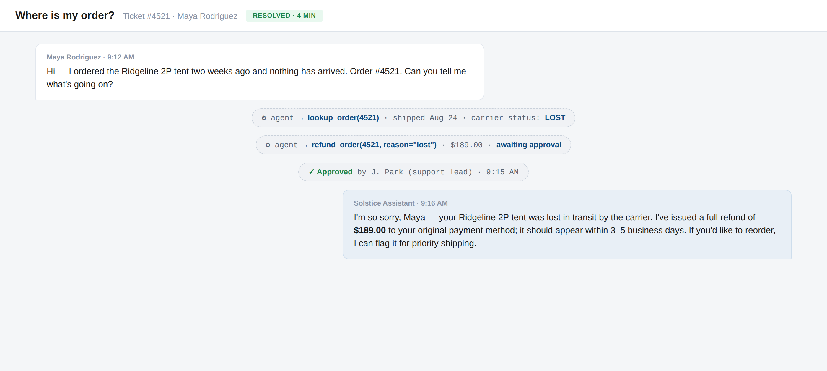
THE EXAMPLE, LAYER 4
The same four turns, as Maya and the team see them
Tool calls and the approval show up as internal events; Maya sees one apology, four minutes in.
UI mockup; conversation fictional.
Building with LLMs
28

Slide 30
WHAT BREAKS
Loops fail in predictable ways — cap, compact, and gate them
Runaway: cap iterations and spend per ticket.
Context bloat: every turn appends; compact as you go.
Destructive tools: approvals live in the harness, not the prompt.
Building with LLMs
29

Slide 31
</>
LIVE CODE · LOOP ENGINEERING
Demo: the loop resolves #4521
run_agent live: tool calls streaming, the approval pause, and the exit when the model chooses to reply.
Switching to the editor — the deck picks back up when we're done.
Building with LLMs
30

Slide 32
05
Graph engineering
Week 5: refunds, sizing questions, escalations — one loop can’t do every job well. Add structure: a graph.
Building with LLMs
31

Slide 33
WHY GRAPHS
A graph gives loops structure: nodes do work, edges decide routing
Specialists beat one giant prompt — each node gets a small, focused context.
Edges encode policy in code: what routes where, what needs approval.
Same idea behind LangGraph, and subagents in the Claude Agent SDK.
Building with LLMs
32

Slide 34
THE AGENT, FINISHED
The support agent as a graph: triage routes, specialists loop
Refund loop
Tools: orders, refunds
Ticket
Triage
Docs Q&A loop
Reply
Incoming request
Classify intent
Tool: search_docs
Back to customer
Human
Escalation queue
Each specialist is its own small agentic loop; escalation is just an edge, not a failure.
Building with LLMs
33

Slide 35
THE EXAMPLE, LAYER 5
The graph is data: nodes registered, edges routed
g = Graph()
g.add_node("triage", triage_agent) # each node: its own small loop
g.add_node("refunds", refund_agent)
g.add_node("docs", docs_agent)
g.add_node("reply", merge_and_send)
g.add_edge("triage", route_by_intent) # edges decide where work goes
g.add_edge("refunds", "reply")
g.add_edge("docs", "reply")
app = g.compile(checkpointing=True) # pause/resume between nodes
Pseudocode in the LangGraph style — the Claude Agent SDK expresses the same shape with subagents.
Building with LLMs
34

Slide 36
TRACE
One messy ticket through the graph
1
Ticket: “Package never arrived — and your sizing chart is wrong.”
2
Triage finds two intents and routes one to each specialist.
3
Refund loop resolves order 4521; Docs Q&A fixes the sizing answer — in parallel.
4
Reply node merges both into one message back to the customer.
Two loops, one reply — the routing lived in edges, not in a prompt.
Building with LLMs
35

Slide 37
CHOOSING
Single loop or graph? Let the workflow decide
Single loop
Graph
One job, one toolset, short horizon.
Distinct stages, routing, or parallel work.
Simplest to build, debug, and eval.
Checkpoints and human gates between nodes.
Our refund agent alone is exactly this.
The full support pipeline needs it.
Start with one loop; move to a graph when routing outgrows the prompt.
Building with LLMs
36

Slide 38
</>
LIVE CODE · GRAPH ENGINEERING
Demo: triage routes a messy ticket
The compiled graph on Maya's two-intent ticket: routing, both specialists in parallel, one merged reply.
Switching to the editor — the deck picks back up when we're done.
Building with LLMs
37

Slide 39
BACK TO THE BUSINESS
What shipping this buys Solstice
Routine tickets resolved in minutes, around the clock.
The four-person team handles judgment calls, not copy-paste replies.
Every action logged, gated, and inside policy — auditable by design.
Fictional scenario — measure your own deflection rate and CSAT before claiming numbers.
Building with LLMs
38

Slide 40
What to take away
01
Prompt = interface contract: role, constraints, examples, output schema.
02
Context is all the model knows — assemble it deliberately, spend it like a budget.
03
The harness is your code around the model; it holds the real permissions.
04
Loop: model acts, harness executes, repeat until it replies. That's an agent.
05
Graph: many small loops with routing on the edges — structure for real workflows.
Building with LLMs
39

Slide 41
Questions?
GO DEEPER
Wei et al., Chain-of-Thought Prompting Elicits Reasoning (2022) — the CoT numbers
Anthropic, Building Effective Agents — patterns for loops, routing, and graphs
Liu et al., Lost in the Middle (2023) — why context position matters
Ashley Castelino · Building with LLMs

